Slide 1

Software Development Lifecycles Models

Slide 2
SDLC Models
A software development life cycle (SDLC) model is a conceptual framework describing all activities in a software development project from planning to maintenance. Most of the models are graphical models, which are drawn representations that employ agreed-upon symbols and conventions.

Slide 3
SDLC Models (cont’d)
predictive SDLC assumes you can predict the complete workflow. It involves fully
understanding the final product and determining the process for delivering it. In this form of project life cycle, you determine the cost, scope, and timeline in the early phases of the project.
SDLC Models
Predictive
e.g. waterfall, prototyping, RAD
Adaptive
e.g. Spiral, Agile, DDSDM,Scrum
Adaptive SDLC approaches have a mix of
incremental and iterative development. It
involves adding features incrementally and
making changes and refinements according to feedback. In other words, the work can easily adapt to the changing requirements based on new feedback received from the client.

Slide 4
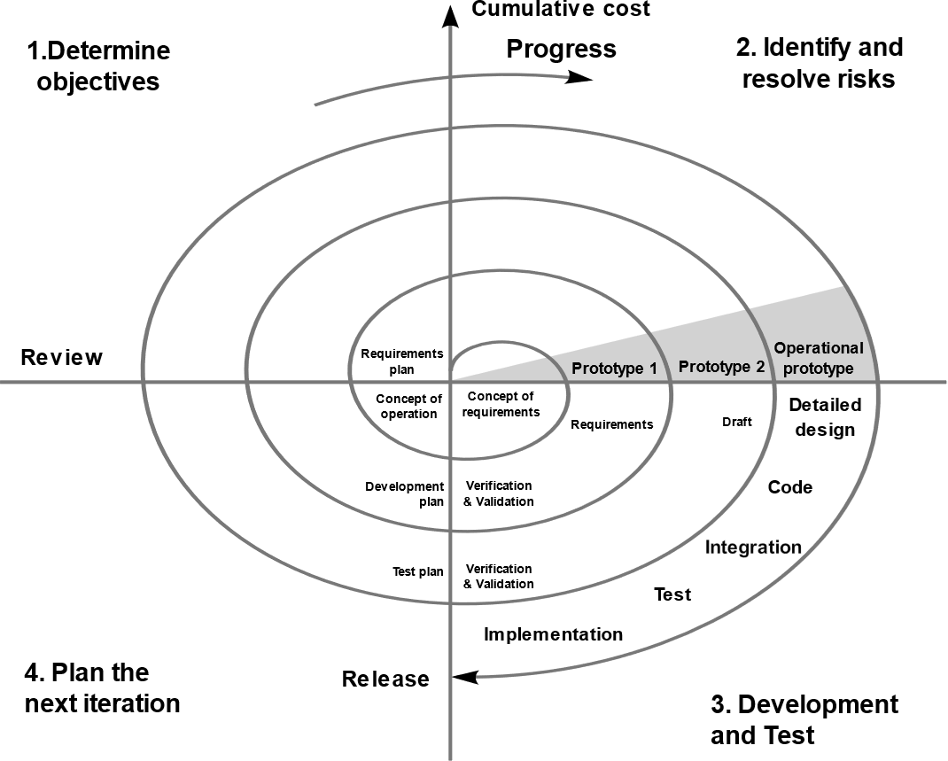
Adaptive Models - Spiral
Spiral model is one of the most important Software Development Life Cycle models, which provides support for Risk Handling. In its diagrammatic representation, it looks like a spiral with many loops.
The exact number of loops of the spiral is unknown and can vary from project to project. Each loop of the spiral is called a Phase of the software development process. The exact number of phases needed to develop the project can be varied by the project manager depending upon the project risks. As the project manager dynamically determines the number of phases, so the project manager has an important role to develop a product using the spiral model.

Slide 5
Adaptive Models - Spiral
The Radius of the spiral at any point represents the expenses(cost) of the project so far, and the angular dimension represents the progress made so far in the current phase.
Also called a meta model since it encompasses all other life cycle models.
Spiral Model includes the iterative nature of the prototyping model and the linear nature of the waterfall model.

Slide 6

Adaptive Models - Spiral
A risk is any adverse situation that might affect the successful completion of a software project. The most important feature of the spiral model is handling these unknown risks after the project has started. Such risk resolutions are easier done by developing a prototype. The spiral model supports coping up with risks by providing the scope to build a prototype at every phase of the software development.
The Prototyping Model also supports risk handling, but the risks must be identified completely before the start of the development work of the project. But in real life project risk may occur after the development work starts, in that case, we cannot use the Prototyping Model. In each phase of the Spiral Model, the risks are identified and are resolved through prototyping. Thus, this model is much more flexible compared to other SDLC models.
Eng. Asmaa Lafi

Slide 7
Kinds of Risks in Software Development
Schedule Risk :Time is not estimated perfectly, Improper resource
allocation, Failure in function identification and its’ completion
Budget Risk: Wrong budget estimation, Cost overruns
Operational Risks: Failure to address priority conflicts, Failure to resolve responsibilities, Insufficient resources, No communication within the team.
Technical Risk : failure of functionality and performance, Continuously changing requirements, The product is complex to implement, Difficult project module integration.
Programmatic Risk: Running out of funds, Changing customer product strategy and priorities, Government rule changes.

Slide 8
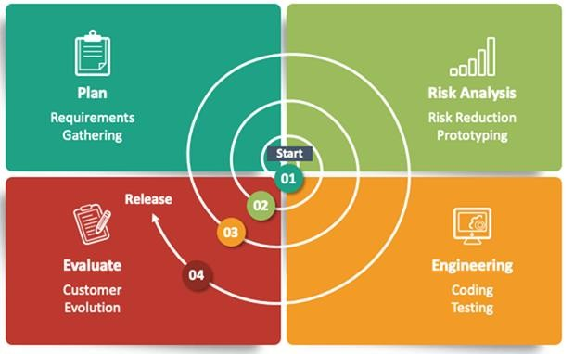
Adaptive Models - Spiral
Planning Phase: Requirements are gathered during
the planning phase (Business Requirement
Specifications-BRS & System Requirement
specifications-SRS)
Risk Analysis: In the risk analysis phase, a process is
undertaken to identify risk and alternate solutions
(prototype is produced at the end of the risk
analysis phase & If any risk is found during the risk
analysis, then alternate solutions are suggested and implemented).
Engineering Phase: In this phase software is
developed, along with testing at the end of the
phase (development and testing is done in this
phase).
Evaluation phase: This phase allows the customer
to evaluate the output of the project to date before the project continues to the next spiral.

Slide 9
Advantages of the Spiral Model
High amount of risk analysis to avoid risk.
Good for large and mission-critical projects.
Strong approval and documentation control.
Additional Functionality can be added later.
Software is produced early in the software life cycle.

Slide 10
Disadvantages of the Spiral Model
Can be a costly model to use.
Risk analysis requires highly specific expertise.
Project’s success is heavily dependent on the risk analysis phase.
Doesn’t work well for smaller projects.

Slide 11
When to use the Spiral Model
When costs and risk evaluation is important
For medium to high-risk projects
Long-term project commitment unwise because of potential changes to economic priorities
Users are unsure of their needs
Requirements are complex
New product line

Slide 12
Adaptive Models - Agile
Agile modeling (AM) is a methodology for modeling and documenting software systems based on best practices.
It is a combination of iterative and incremental process models with focus on process adaptability and customer satisfaction by rapid delivery of working software product.
Agile Methods break the product into small incremental builds. These builds are provided in iterations. Each iteration typically lasts from about one to three weeks. Every iteration involves cross functional teams working simultaneously on various areas
This methodology is more flexible than traditional modeling methods, making it a better fit in a fast-changing environment.

Slide 13
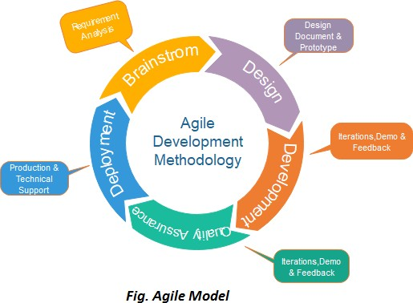
Adaptive Models - Agile

Slide 14
Adaptive Models – Agile (Agile phases)
In this phase, you must define the requirements. You should explain business opportunities
and plan the time and effort needed to build the project. Based on this information, you
Requirements
gathering
can evaluate technical and economic feasibility
When you have identified the project, work with stakeholders to define requirements. You can use the user flow diagram or UML diagram to show the work of new features and show how it will apply to your existing system.
Design the requirements
When the team defines the requirements, the work begins. Designers and developers start working on their project, which aims to deploy a working product. The product will undergo various stages of improvement, so it includes simple, minimal functionality.
Development/
iteration

Slide 15
Adaptive Models – Agile (Agile phases)
In this phase, the Quality Assurance team examines the product's
performance and looks for the bug.
Testing/ Quality
assurance
In this phase, the team issues a product for the user's work
environment.
Deployment
After releasing the product, the last step is feedback. In this, the team
receives feedback about the product and works through the feedback.
Feedback

Slide 16
Advantages of the Agile Model
Customer satisfaction by rapid, continuous delivery of useful software.
People and interactions are emphasized rather than process and tools.
Customers, developers and testers constantly interact with each other.
Working software is delivered frequently (weeks rather than months).
Face-to-face conversation is the best form of communication.
Daily cooperation between businesspeople and developers.
Continuous attention to technical excellence and good design.
Adaptation to changing circumstances.
Late changes in requirements are welcomed

Slide 17
Disadvantages of the Agile Model
In case of some software deliverables, especially the large ones, it is difficult to assess the effort required at the beginning of the software development life cycle.
There is lack of emphasis on necessary designing and documentation.
The project can easily go off track if the customer representative is not clear what outcome that they want.
Only senior programmers are capable of taking the kind of decisions required during the development process.
Risky for new programmers, unless combined with experienced resources.

Slide 18
When to use the Agile Model
When new changes need to be implemented. New changes can be
implemented at very little cost because of the frequency of new increments that are produced.
To implement a new feature the developers need to lose only the work of a few days, or even only hours, to roll back and implement it.
At unclear requirements. Agile assumes that the end users’ needs are ever changing in a dynamic business and IT world. Changes can be discussed and features can be newly effected or removed based on feedback. This effectively gives the customer the finished system they want or need.

Slide 19
Agile-Based Approaches
Scrum
Kanban
Extreme Programming (XP)
Lean Software Development
Feature-Driven Development (FDD)
Adaptive Software Development (ASD)
Dynamic Systems Development Method (DSDM)

Slide 20
Adaptive Models - DSDM
The Dynamic Systems Development Method (DSDM ) provides a framework of
controls and best practice for Rapid Application Development (RAD) and later its used as framework of Agile model.
It is particularly suitable for application development projects that need to develop complex business solutions within tight timeframes.
In DSDM, time is fixed for the life of a project, and resources are fixed as far as possible. This means that it is the requirements that will be satisfied that are allowed to change.
DSDM Eliminate problems of: Going over-budget, Missing deadlines and Users not involved

Slide 21
Adaptive Models – DSDM Phases
The actual DSDM lifecycle is broken down into seven different phases, these are:
Pre-Project Phase,
Feasibility Study,
Business Case Study,
the Functional Model Iteration (FMI),
the Design and Build Iteration (DBI),
the Implementation Phase
the Post-Project Phase.

Slide 22
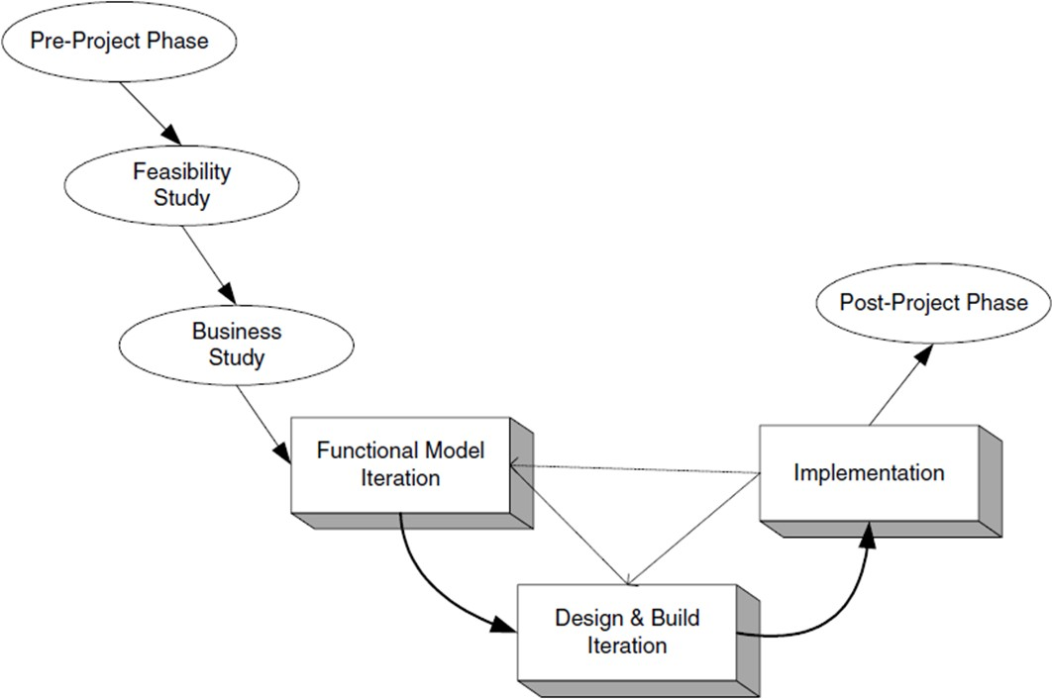
Adaptive Models – DSDM Phases

Slide 23
Adaptive Models – DSDM Phases
Pre-Project: Identify a project, Have funding, Have commitment
The first three phases (namely, the Pre-Project, Feasibility and Business Studies phases) are done sequentially in order.
The feasibility study phase produce feasibility report also define the general scope of the project and its objectives. This phase should also produce an outline plan for the development of the end product.

Slide 24
Adaptive Models – DSDM Phases
The Business Study phase of the project should have three outputs; these should be the Business Area Definition (BAD), the System Architecture Definition (SAD) and the Outline Prototyping plan:
Business Area Definition. Identifies the high-level requirements and provides a process description of the end product.
System Architecture Definition. Sketches out the architecture of end system. Note that it is likely that this will evolve over the life of the project.
Outline Prototyping Plan. This states the prototyping strategy to be adopted for the development of the end product.

Slide 25
Adaptive Models – DSDM Phases
The core phases of the DSDM are the FMI (functional model Iteration), the DBI and
the Implementation Phase
The FMI Phase involves:
Analysis of the features to be designed and implemented.
The production of the Functional Model. This is the primary output of this phase. It may include prototype code as well as analysis models.
Coding and prototyping. Prototypes may be used to help improve the analysis or understanding of the system. These prototypes may continue to evolve (particularly in the next phase) until the quality level achieved is high enough that they can be used in the delivered system.

Slide 26
Adaptive Models – DSDM Phases
The DBI (Design and Build Iteration) Phase involves:
Designing and Building the features to be implemented during this phase. This involves reviewing the designs produced so far, the functional prototypes, as well as the creation of code to implement the required functionality.
The primary output of this state is the tested system. This system must meet all the requirements selected as essential in the particular iteration being implemented.

Slide 27
Adaptive Models – DSDM Phases
The Implementation Phase involves:
The transfer of the completed system from the development environment to the production environment.
The provision of other deliverables such as User training, the creation of the User Manual and the Project Review Report.
If issues arise, then the project can be reiterated back to the appropriate phase.
The core three phases, the FMI, the DBI and the Implementation Phase are expected to be iterative and incremental.
post-project phase providing a help desk for users to ensure that the product operates effectively and checking that the expected business benefits have been achieved.

Slide 28
Advantages of the DSDM Model
Improves collaboration
Help to enhance communication efforts across various cross-functional teams and departments.
Minimize confusion since everyone remains updated on the latest developments that occur within the project.
Supports rapid deliverables
Allows product teams to release their deliverables rapidly, minimizing delays and attending to a reasonable timeline.
Helps teams increase efficiency, meet client needs and achieve a launch sooner.

Slide 29
Advantages of the DSDM Model cont.
Promotes feedback
Encourages teams to stay in close communication with interested parties to receive frequent feedback and suggestions.
Enhances project organization
There are a variety of tools and strategies they can use to help better manage
the overall operation.
Sets clear guidelines
Help teams manage their efforts to ensure they meet deadlines and stay
within the budget.

Slide 30
Disadvantages of the DSDM Model
Requires resources
Can be costly to implement. Although it requires an investment to implement, it may also save an organization money by encouraging teams to work efficiently and reducing time-to-market for products.
Minimizes creativity
It encourages developers to work quickly, it may limit risk-taking. The focus on iterative development may allow professionals to revisit their work to infuse more unique, creative elements later.

Slide 31
Scrum
Scrum entails an iterative approach to project management. The Scrum methodology prescribes breaking a project down into sprints that typically only last one to four weeks. Each sprint ends with the completion of a workable version or draft of the final project deliverable.
The Scrum approach’s short iterations enable your team to continuously deliver a working version of the final product.
It’s flexible enough to be used for any complex project in any industry but works best when your project results in a concrete product rather than a service.

Slide 32
Scrum Roles and Responsibilities
Scrum in Agile requires particular roles and responsibilities, including the following:
Product owner: The product owner on a project is the person responsible for representing the customer’s best interest. This person has the ultimate authority over the final product. The product owner’s job is to ensure product requirements, functionality, and priorities are understood and achieved.
Scrum master: The Scrum master is responsible for arranging the daily meetings, improving team interactions, and maximizing productivity. The difference between the project manager and Scrum master is that the latter focuses on being a servant leader. The Agile project manager’s roles and responsibilities often include the position of Scrum master. However, they can delegate this to anyone on the team who’s a Scrum expert and a strong facilitator.

Slide 33
Scrum Roles and Responsibilities
Scrum in Agile requires particular roles and responsibilities, including the following:
Development team: The development team is your Scrum project team. It’s typically self-organized and cross-functional. This team includes all the people necessary to design, produce, test, and release the final product.
Scrum team: The Scrum team structure includes your development team, Scrum master, and product owner.

Slide 34
Scrum Terminology
The following are key terms commonly used in the Scrum framework:
Product backlog: The backlog is a list of tasks and requirements that you must include in the final product. It’s the product owner’s responsibility to create and manage the backlog.
Sprint: A sprint is a set time frame for completing each set of tasks from the backlog. Every sprint should be the same length. Two weeks is typical, but the sprint can be anywhere between one to four weeks, depending on the team and project’s needs.
Backlog planning: (sometimes called Agile sprint planning) refers to determining which tasks on the backlog list you will include in each sprint.
Sprint backlog. The portion of the backlog that is assigned to the current sprint.

Slide 35
Scrum Terminology
Daily Scrum: A Scrum project team meets every day to discuss any progress over the last 24 hours, progress expected in the next 24 hours, and any new problems. These meetings are typically referred to as a Daily Scrum or Daily Stand-Up and generally take about 15 minutes.
Retrospective: Each sprint should end with a review meeting called a retrospective. The team reviews their progress so far and discusses how they can improve in the next sprint.
Scrum board: A Scrum board helps your team see and manage the sprint backlog. It can be a physical board, such as a whiteboard, or a virtual one within a project management tool. The board typically has three columns: “To Do,” “In Progress,” and “Done.” As you complete backlog items, you move them from one column to the next on the board. This way, everyone can see what they need to do during the current sprint and how the work progresses.

Slide 36
When to use Scrum
The Scrum framework is ideal for adopting a highly structured approach to project management whereby you tackle every aspect of your project in a systematic way.
That makes it an excellent choice for complex projects that can feel intimidating at first. By breaking a project down into achievable sprints, you can make it feel less overwhelming and make significant progress in a short space of time.
The Scrum framework is also best for projects that are prone to change in scope over time. Since you’ll have a Scrum leader composing the orchestra on individual projects, working this way allows you to pivot quickly and redirect the team’s energy when required.
The additional control you get over the way your team works will also benefit you for projects that require closer management and adaptability.

Slide 37
References
https://www.geeksforgeeks.org/software-engineering-spiral-model/
https://inoxoft.com/blog/7-software-development-models-comparison-how-to-choose-the-right-one/
https://www.scribd.com/document/390112233/Agile-SDLC-Model-is-a-Combination-of-Iterative-and-Incremental-Process-Models-With-Focus-on-Process-Adaptability-and-Customer-Satisfaction-by-Rapid-De
https://www.techtarget.com/searchsoftwarequality/definition/agile-software-development
https://www.tutorialspoint.com/sdlc/sdlc_agile_model.htm
https://geeksforgeeks.org/dynamic-systems-development-method-dsdm/

Slide 38
References
https://www.wrike.com/project-management-guide/faq/kanban-vs-scrum-vs-scrumban-what-are-the-differences/

